Slide 1
Krotos Audio – Customer Segmentation & Retention Analysis
💬 Evangelos Argyropoulos, 23-05-2025, εργαλείο: BigQuery, Looker Studio, Excel

Slide 2
Objective of the Analysis
Understand user purchase behavior
Group customers into meaningful RFM segments
Analyze retention trends over time (cohort analysis)
Provide actionable marketing recommendations

Slide 3
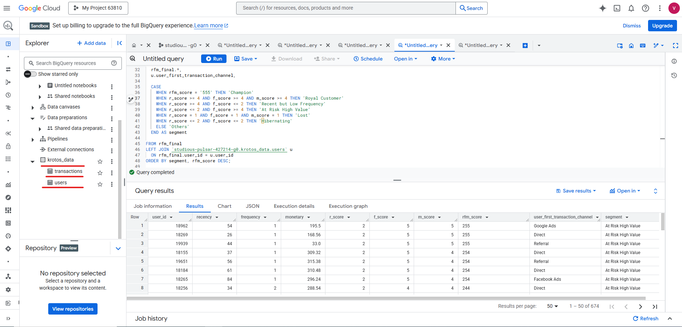
Database & Data Source Overview
The source tables (transactions, users) were uploaded directly into BigQuery using CSV form
No manual schema creation was required
The data was then queried using SQL for RFM and Cohort analysis.
If this analysis was implemented in PostgreSQL, the Foreign key relationships would be “transactions.user_id → users.user_id”

Slide 4
Methodology – RFM Framework
Recency – Days since last purchase
Frequency – Number of total purchases
Monetary – Total amount spent
Customers are scored from 1 (low) to 5 (high) on each metric
Final RFM Score = combination of R, F, M → e.g. 555, 341, etc

Slide 5
Methodology Overview
Emoji | Segment Name | SQL Logic | Description
🏆 | Champion | rfm_score = '555' | Best customers: bought recently, frequently, and spent a lot
🔁 | Loyal Customer | r_score >= 4 AND f_score >= 4 AND m_score >= 4 | Very active customers with strong RFM scores
🧪 | Recent but Low Frequency | r_score >= 4 AND f_score <= 2 | New customers, not frequent yet
⚠️ | At Risk High Value | r_score <= 2 AND f_score >= 4 | High spenders who haven't returned in a while
🛌 | Hibernating | r_score <= 2 AND f_score <= 2 | Low activity & low spending for a long time
❌ | Lost | r_score = 1 AND f_score = 1 AND m_score = 1 | Completely inactive — unlikely to return
🤔 | Others | ELSE | Intermediate or undefined behavior

Slide 6
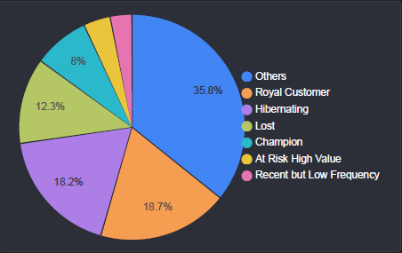
RFM Segmentation Overview

Slide 7
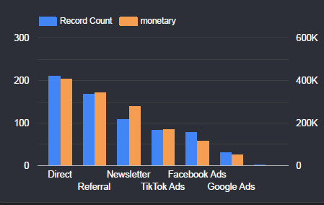
Acquisition Channel Effectiveness

Slide 8
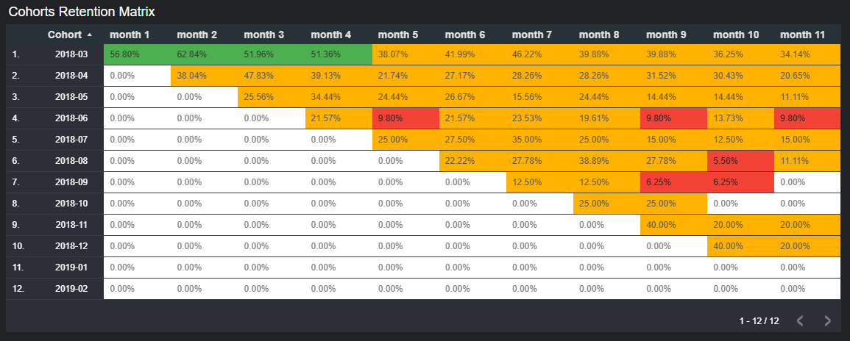
Retention Analysis

Slide 9
✅ Recommendations by RFM Segment (based on the pie chart)
Segment | % of Users | Action | Goal
🏆 Champion | 8% | Offer exclusive perks, early access, or request testimonials | Keep them engaged & turn into brand advocates
🔁 Royal Customer | 18.7% | Launch loyalty/referral program, provide VIP benefits | Strengthen relationship, upgrade to Champions
⚠️ At Risk – High Value | 3.9 % | Personal outreach, special limited-time offers | Recover valuable users before they churn
🛌 Hibernating | 18.2% | Send win-back email campaigns with discounts | Reactivate before becoming Lost
❌ Lost | 12.3% | Exclude from paid ads, consider low-cost reactivation | Avoid budget waste on low-probability return
🧪 Recent but Low Freq | 3.1 % | Trigger onboarding email flows, recommend follow-up purchases | Encourage second purchase, move into Loyal segment
🤔 Others | 35.8% | Analyze further – likely undefined or inactive users | Reclassify and segment properly for future targeting

Slide 10
✅ Recommendations by Cohort Analysis
Insight | Recommendation
🟢 Strong performance in early 2018 cohorts (03–05) | Analyze acquisition channels, offers, and UX during that time – replicate what's working
🟡 Moderate retention until month 3–4 in 2018-04 to 2018-07 | Reinforce retention strategies around months 2–4 with reminders, loyalty incentives
🔴 Sharp drop after month 4 in all cohorts | Introduce retention hooks (e.g. exclusive benefits, milestone rewards) around month 3
🟠 Post-2018-10 cohorts show minimal engagement | Investigate changes in product, onboarding, or campaign targeting after Oct 2018
🧪 Some small spikes (e.g. 2018-11 month 9) | Identify what caused isolated reactivation & test it intentionally (e.g. email/promo)
⏱️ Most drop-off occurs after first or second month | Strengthen early lifecycle: onboarding flows, personalized nudges, early offers
📅 Retention decays steadily but predictably | Use this to forecast Lifetime Value& plan lifecycle marketing automations accordingly

Slide 11
👉 Cohort Retention Insights – What We Learned
March–May 2018 cohorts outperform others: investigate and replicate
After month 3, retention drops below 30% → needs re-engagement strategy
Focus retention tactics around months 1–4

Slide 12
Tools & Data
SQL queries (Google BigQuery)
Retention matrix (Excel/Sheets)
Dashboards (Looker Studio)
Data sources: transactions, users

Slide 13
Interactive Dashboard (Looker Studio)
💬 "Explore the full dashboard here:"
🔗 Click to open the live report

